Slide 1
Polymers
Dr. Druman Utekar

Slide 2
Definition
Polymer is high molecular weight substance formed by joining a large number of small repeating units called as Monomers.
In Greek language poly means many & mer means units
Polymers form very important components in our daily life. The polymers are highly useful in domestic industrial & medical fields.

Slide 3
Examples
Rubber
Polyethene,
Polypropylene
Teflon
nCH₂=CH₂ polymerization (CH₂ – CH ₂) _{n}

Slide 4
The following are the reasons for the extensive use of polymers.
Most of the polymers are non-toxic & safe to use.
They have low densities (light in weight) so transportation polymers will be easy.
They posses good mechanical strength.
These are resistant to corrosion and will not absorb moisture when exposed to the atmosphere.
These can function as good thermal & electrical insulators.
These can be moulded and fabricate easily.
They possess aesthetic colors.

Slide 5
But the limitations for the use of polymers are
Some polymers are combustible.
The properties of polymers are time dependent
Some of them cannot with stand high temperature.

Slide 6
Classification of polymers
Based on source
Based on Physical State
Amorphous and semi crystalline
C) Based on Thermal Behavior or Response to Heat.-
D) Based on end use.-Fibres, Plastics, Elastomers, Films, Paints, Adhesives
E) Based on Origin
F) Based on Tacticity

Slide 7
Classification of polymers
G) Based on Conductance
H) Based on Environment Friendly Nature
Based on the type of monomers
J) Based on Number of Monomers
K) Based on Chemical Nature
L) Based on Growth Mechanism of Polymerization

Slide 8
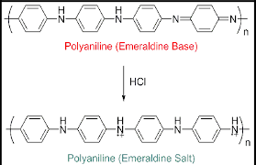

Slide 9
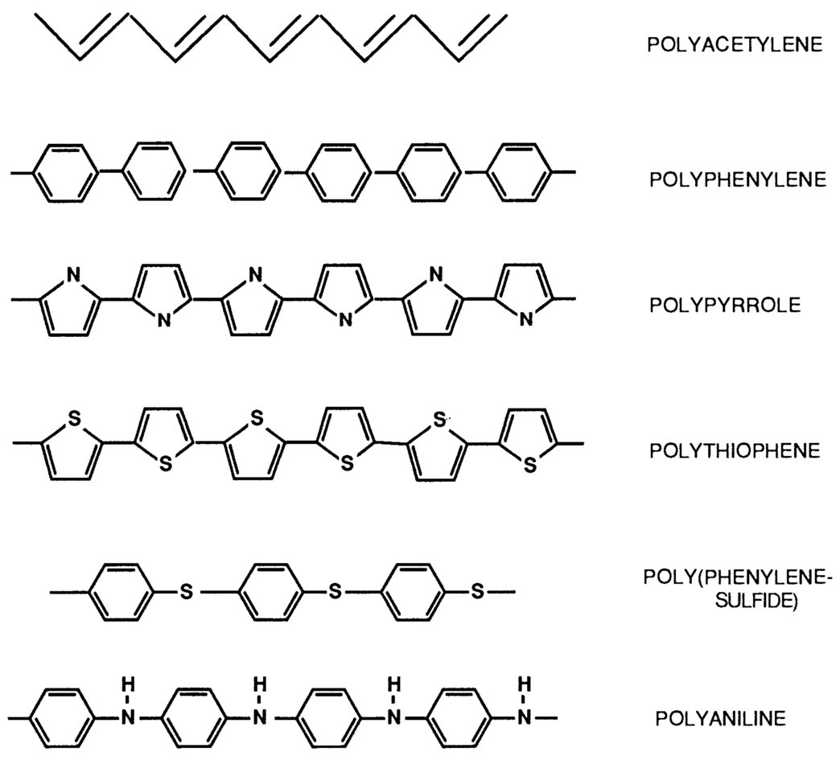

Slide 10
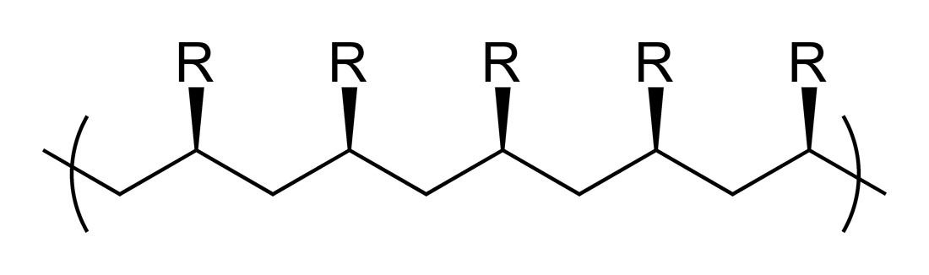
Based on Tacticity
The arrangement of functional groups on carbon backbone of the polymer is called Tacticiy.
It is manly divided into 3 types.
Isotactic polymers: Those polymers in which the functional groups are arranged on the same side are called Isotactic polymers. E.g.:- PVC

Slide 11
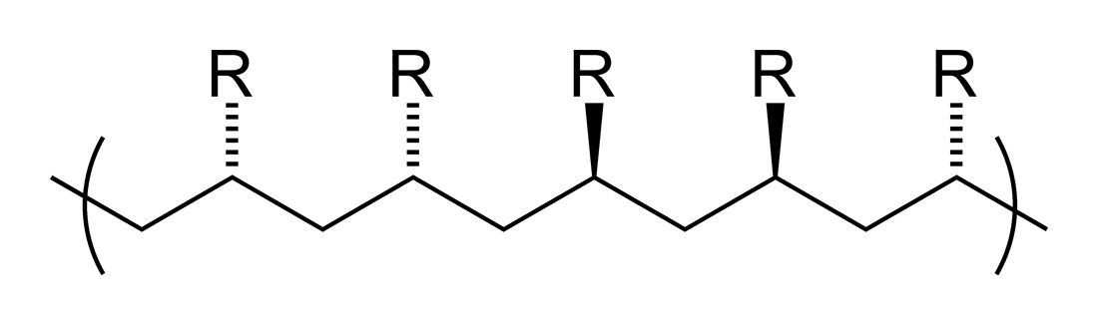
Atactic polymers: When there is no regular arrangement of functional groups on the back bone of the polymer chain these polymers are called atactic polymers.
E.g.: PVC (Poly Vinyl chloride)

Slide 12
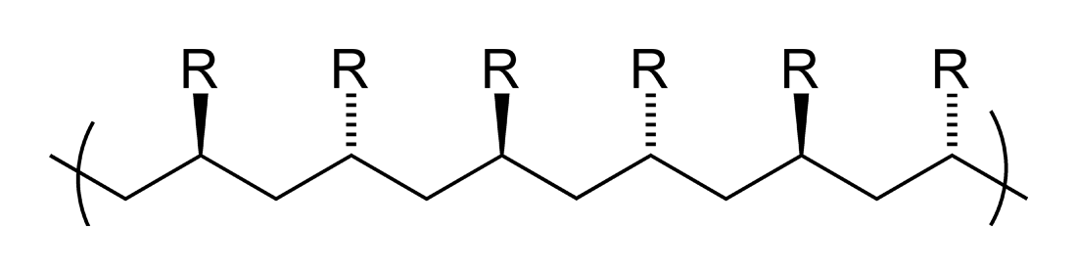
Syndiotactic Polymers: The polymers with alternate arrangement of functional groups are called syndiotactic polymers for e.g.:- PVC

Slide 13
Difference between condensation and addition polymerisation:-
 | Condensation polymerisation |  | Addition polymerisation
(1) | It is also known as step growth | (1) | It is also known as chain growth
 | polymerisation |  | polymerization
(2) | It takes place in monomers having | (2) | It takes place only in monomers
 | reactive functional groups |  | having multiple bonds.
(3) | It takes place with elimination of | (3) | It takes place without elimination of
 | simple molecule like H₂O,NH₃,HCl |  | simple molecule.
 | etc.,
(4) | Repeat units of monomers are | (4) | Repeat units & monomers are same.
 | different
(5) | The polymer is formed in gradual | (5) | Reaction is fast and polymer is formed
 | steps |  | at once.
(6) | The molecular mass of polymer | (6) | There is very little change in the
 | increases throughout the reaction |  | molecular mass throughout the
 |  |  | reaction
(7) | Product obtained may be | (7) | Product obtained are thermoplastic
 | thermosetting/thermoplastic
(8) | E.g.:- Bakelite, polyester ,polyamides | (8) | E.g:-Polyethylene, PVC, poly styrene.
 | etc.,

Slide 14
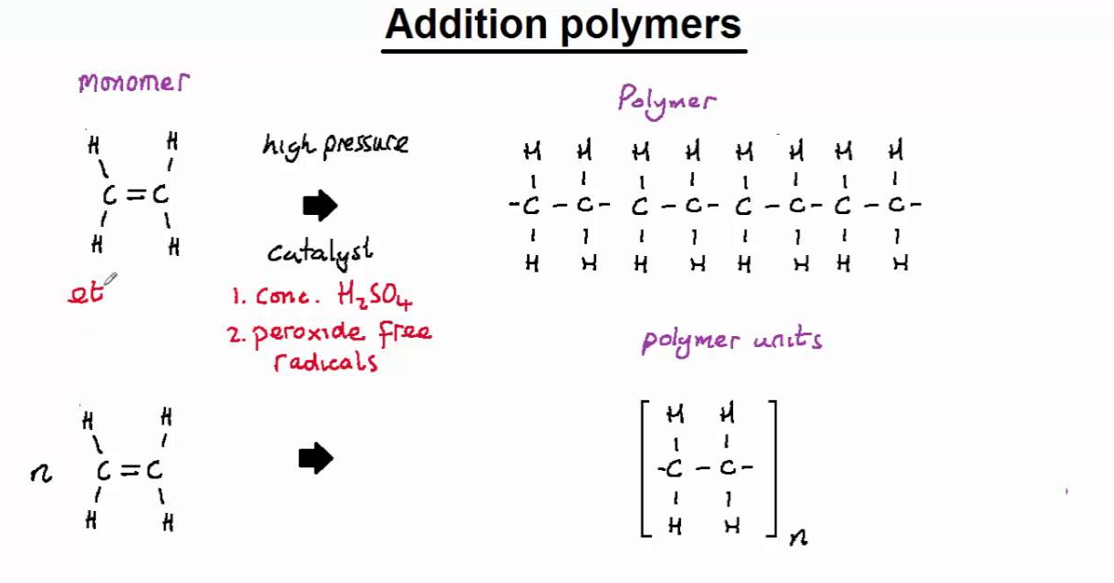

Slide 15
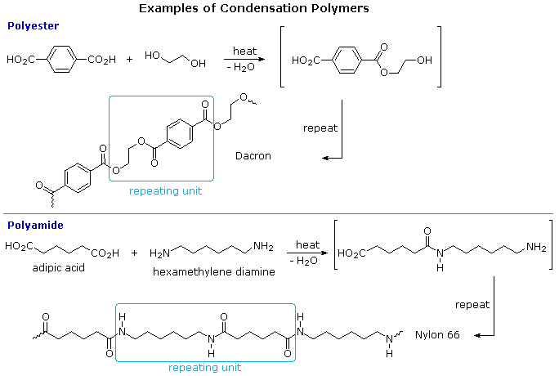

Slide 16
Difference between thermoplastic & thermosetting resins:-
Thermoplastic resins (or) Polymers |  | Thermosetting resins
(1) | These are produced by addition | (1) | These are produced by
 | polymerization |  | condensation polymerization.
(2) | The resins are made of long chains | (2) | The resins have three dimensional
 | attached by weak Vander Waal’s |  | network structure connected bonds.
 | force of attraction
(3) | On heating they soften and on | (3) | On heating they become stiff &
 | cooling become stiff chemical |  | hard. No change on cooling.
 | nature won’t change. |  | Chemical nature changes.
(4) | They can be remoulded | (4) | They cannot be remoulded because
 |  |  | once set means they are
 |  |  | permanently set
(5) | Scrap (waste product) can be used | (5) | Scrap cannot be used
(6) | The resins are soft, weak and less | (6) | The resins are usually hard, strong
 | brittle |  | tough & more brittle
(7) | These are easily soluble in some | (7) | Resins are not soluble in organic
 | organic substances |  | Solvents
 | E.g.:- PVC, polyethylene etc., |  | E.g.:- Nylon, Bakelite etc.,
(8) | Contain long chain polymer with no | (8) | They have 3D network structure.
 | cross linkage.

Slide 17
Molecular Mass of Polymer
The molecular mass of polymer is an important property of polymer because many important properties are influenced by molecular mass. Polymers with higher molecular mass are tougher and more resistant. Their viscosities and softening temperature are also higher. Thus polymers with molecular mass are often required for particular purposes.
Molecular mass of polymer is not a fixed or constant value like organic compound. Their molecular mass is controlled by polymerization reaction, which in turn depend upon availability of functional group, charge carrier, life time of charge carriers. Because of random nature of growth process, the product of polymerization process is mixture of chains of different length.
Hence polymers are poly disperse mixture of various molecular mass polymers. Therefore molecular mass of polymers is average molecular mass.

Slide 18
Average molecular mass of polymers can be expressed in following ways
__
1. Number Average Molecular Mass (Mn)
2. Weight Average Molecular Mass (Mw)
3. Z-Average Molecular Mass (Mz)
4. Viscosity average Molecular Mass (Mv)

Slide 19
Methods for determining the molecular weights of polymer
A) Primary or Absolute methods, which are capable of determining molecular weights from first principles like colligative property measurements(Which gives Mn) , light scattering measurements (which gives Mw)
B) Secondary or relative methods, Which require calibration with samples of known molar mass. Examples Viscosity measurements which gives Mv.

Slide 20
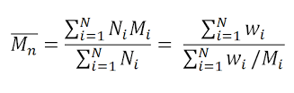
Number average Molecular Mass ( Mn)
In this number of molecules are involved in the molecular weight measurements.
Hence the molecular weight is obtained by colligative property measurements and
known as number average molecular weight.
Let us consider N1,N2, N3….. be the number of molecules of polymer in a sample solution.
And M1, M2, M3 …be the their molecular weight then Number average molecular weight
is given by
Polymer solution of polyethene | Number of molecules | Their molecular weight
Sample has | 100 N1 | 150 M1
 | 200 N2 | 200 M2
 | 300 N3 | 300 M3

Slide 21
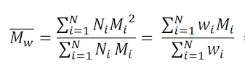
Weight Average molecular Weight
Let us consider N1,N2, N3….. be the number of molecules of polymer in a sample solution.
And M1, M2, M3 …be the their molecular weight
And W1, W2, W3 …be the their weight(mass) then Weight average molecular weight is given by
Polymer solution of polyethene | Molecular weight | Their weight
Sample has | 100 | 15g
 | 200 | 20g
 | 300 | 30g

Slide 22
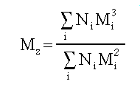
Z-average molecular Weight
Let us consider N1,N2, N3….. be the number of molecules of polymer in a sample solution.
And M1, M2, M3 …be the their molecular weight, then Z-average molecular weight is given by

Slide 23
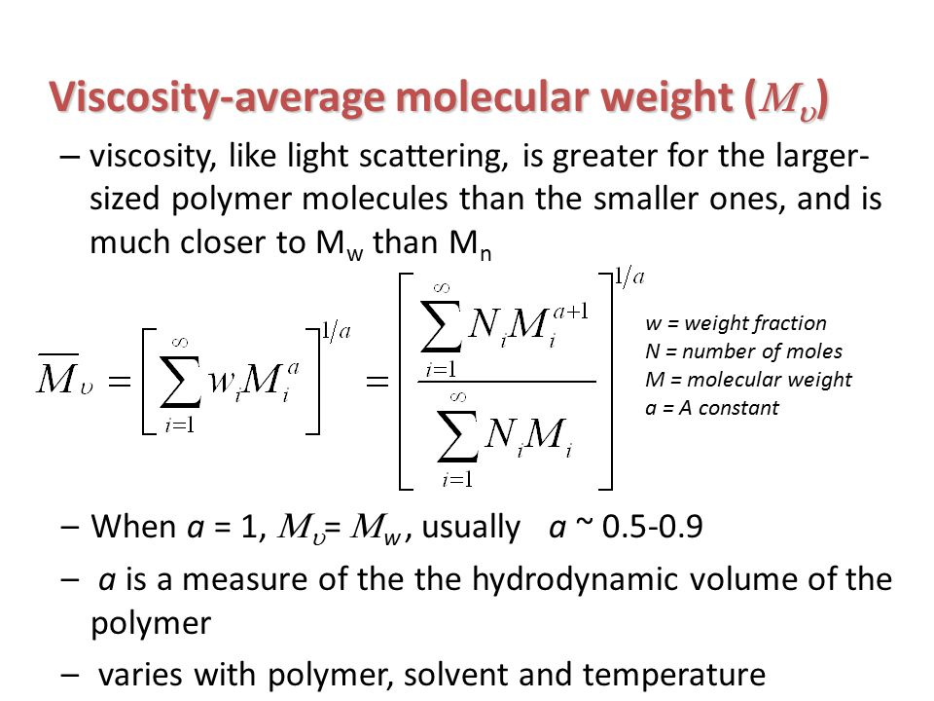

Slide 24
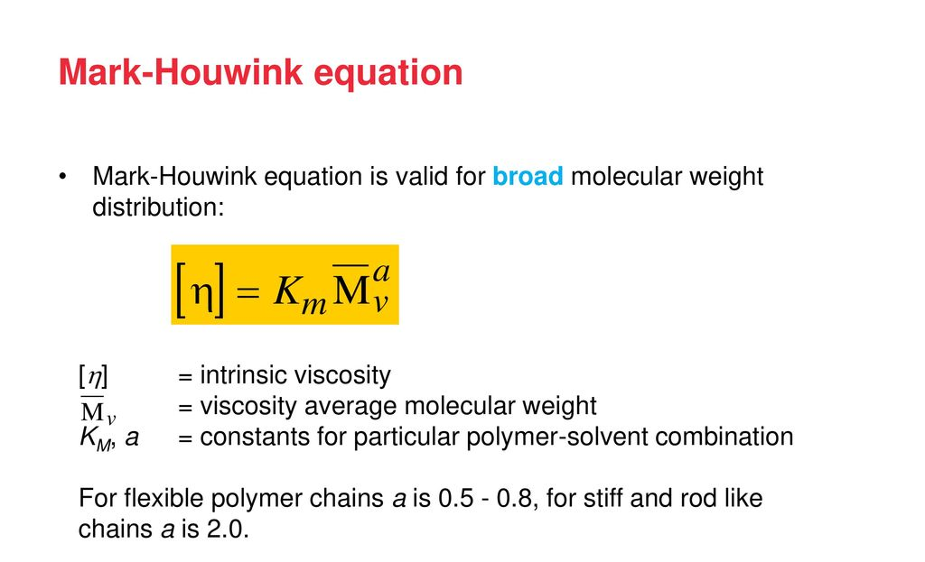
Viscosity Average molecular weight
By Mark Howick Equation

Slide 25
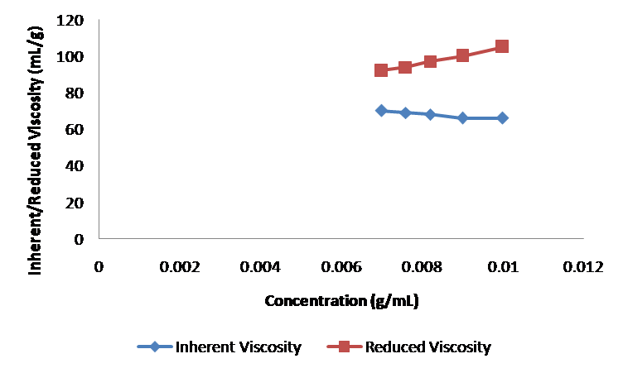

Slide 26
Compounding of Plastics
In order to impart certain definite properties to the finished products, resins are compounded with certain other substances. The process is called as compounding of plastics.

Slide 27
1. Binders or Resins
The product of polymerization is called resins and this forms the major portion of the body of plastics.
It is the binder, which holds the different constituents together.
Thermosetting resins are usually, supplied as linear – polymers of comparatively low molecular weight, because at this stage they are fusible and hence, mouldable.
The conversion of this fusible form into cross-linked infusible form takes place, during moulding itself, in presence of catalysts etc.
A binder may compose of 30-100%.
The binders used may be natural or synthetic or cellulose derivatives.

Slide 28
2. Fillers
Fillers are generally added to thermosetting plastics to increase elasticity and crack resistance.
Fillers improve thermal stability, strength, non combustibility, water resistance, electrical insulation properties & external appearance.
E.g.:- Mica(Hardness), cotton(Shock resistance) , carbon(electrical conductivity) black, graphite, BaSO4 etc. Asbestos ( Heat resistance)

Slide 29
3. Plasticizers
Plasticizers are substances added to enhance the plasticity of the material and to reduce the cracking on the surface.
Plasticizers are added to the plastics to increase the flexibility & toughness. Plasticizers also increase the flow property of the plastics.
Commonly used plasticizers are vegetable oils, camphor, esters of steric, oleic acid, tributyl phosphate, triphenyl phosphate etc.

Slide 30
4. Dyes and Pigments
These are added to impart the desired colour to the plastics and give decorative effect.
e.g.:-Inorganic Pigments: Lead chromate (yellow), ferro cyanide (blue)
Organic Pigments: Alizarin Red, Indigo Dye, Azo dyes.

Slide 31
5. Lubricants
Includes Oils, waxes and soaps.
They help in easy moulding and glossy finish to final product.
The lubricant prevent the plastic materials from sticking to the mould.

Slide 32
6. Catalysts
They are added to plastics to accelerate polymerizations reaction.
ZnCl2, CaO, ammonia, benzoyl peroxides

Slide 33
7. Stabilizers
They are added to improve thermal stability during processing. Eg. Polymers of vinyl chloride show a tendency to undergo decomposition at moulding temperatures. So during their moulding heat stabilizers are added.
i) Opaque moulding stabilizers: Salts of lead, like white lead, lead chromate, red lead, lead silicate etc.
Ii) Transparent Moulding stabilizers: Stearates of Lead, chromium and barium.

Slide 34
In addition small quantitates of antioxidants, antiseptics, fungicides, flame retardants etc. are added as ingredient of plastics.

Slide 35
FABRICATION OF PLASTICS
Giving any desired shape to the plastics (granules or powders) by using mould under the application of heat and pressure.
A proper method is to be selected depending on the shape and type of resin used.
Methods involves partial melting of resinous mass by heating.
In case of thermo-plasts molten resin is introduced in die/mould and desired shape could be achieved by compression and further cooling.
In case of thermo-sets partially polymerized mass or raw materials are introduced in the die/mould, which further cured at high temperature in the mould itself to achieve desired shape.
In case of thermoplasts, curing is done at room temperature (low temperature)
2. In case of thermosets, curing is done at high temperature to obtain desired cross-linking

Slide 36
TYPES OF FABRICATION
[I} Compression Molding (Suitable for Thermosets / Thermoplasts)
[II] Injection Molding (Suitable for Thermoplasts)
[III] Transfer Molding (Suitable for Thermosets)
[IV] Extrusion Molding (Suitable for Thermoplasts)

Slide 37
COMPRESSION MOULDING
Common and oldest method for molding thermosetting / thermoplastic materials
Compression of raw materials or soften resinous mass is done in the mould /die under heat and pressure

Slide 38
COMPRESSION MOULDING
Predetermined quantity of raw materials is introduced carefully in the mould, further compressed by hydraulic pressure (2000 to 10000 psi)
Molten or soften resinous mass gets filled in the cavity of mould.
Curing is done by heating (Thermosetting) or by cooling (Thermoplastics)
Finally moulded article is separated from the mould by opening the mould apart.
Applications : Electric switch boxes, Ash trays, cabinets for radio, television, computers etc.

Slide 39
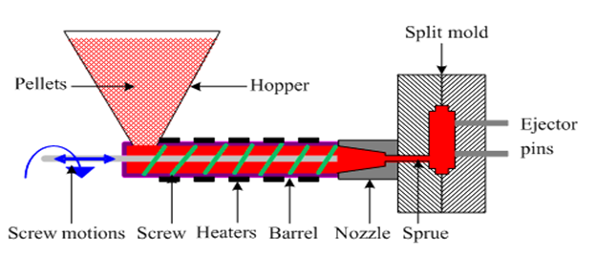
INJECTION MOULDING

Slide 40
INJECTION MOULDING
This method is especially used for thermoplastic materials
Powder or granular resin is heated in a cylinder and injected at a controlled rate in a mould with the help of piston plunger or screw.
Piston plunger or screw is used to force the material in mould.
Pressure up to 2000 kg/cm2 (100 psi) is used
Once the article is formed mould is cooled and half mould is opened to remove the finished article.
Disadvantage of the method is formation of air bubbles or cavities in the articles
Applications: Smaller but large volume articles such as, pen caps, bottle caps, cups, containers, mechanical parts

Slide 41
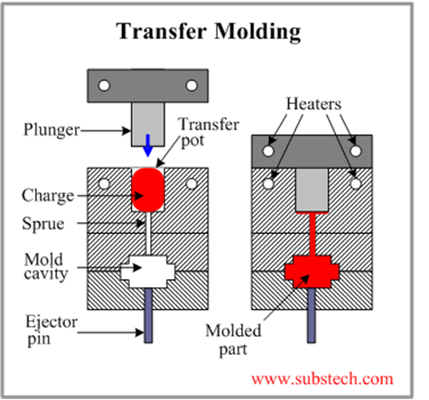
TRANSFER MOULDING

Slide 42
TRANSFER MOULDING
The method combines features of both Compression Molding (hydraulic pressing of molding materials - thermosets) and Injection Molding (ram-plunger and filling the mold through a sprue).
The method is used especially for molding thermosetting resins (thermosets)
Products with relatively intricate designs could be fabricated with this method
Powdered raw materials are heated at certain low temperature to soften and then introduced through an orifice or sprue in the mould
Then it is cured in the mould at high temperature for certain time
Finally the moulded article is removed by separation of mould
Advantages:
Articles with intricate shapes could be designed
Aerospace and automobile parts, car body, helmets
The articles produced are blister free
Fine wires and glass fibers can be inserted in the mould
Even thick pieces can be cured completely and uniformly

Slide 43
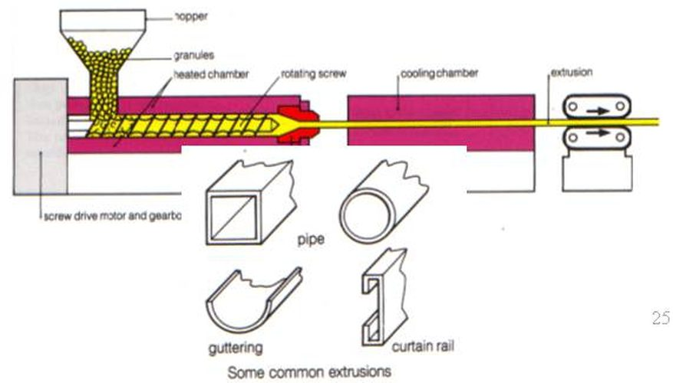
Extrusion Molding

Slide 44
Extrusion Moulding
Whenever continuous molding of material like wires, cables, and sheets is required extrusion molding is used. The thermoplastic materials are molded by this method. They undergo continuous molding to form articles of uniform cross section. In this method, the thermoplastic material are heated to plastic condition and pushed by means of screw conveyor in to a mould cavity having required outer shape of articles to be manufactured. Here the plastic mass gets cooled due to atmospheric exposure. A long conveyor carries away the cooled products continuously.

Slide 45
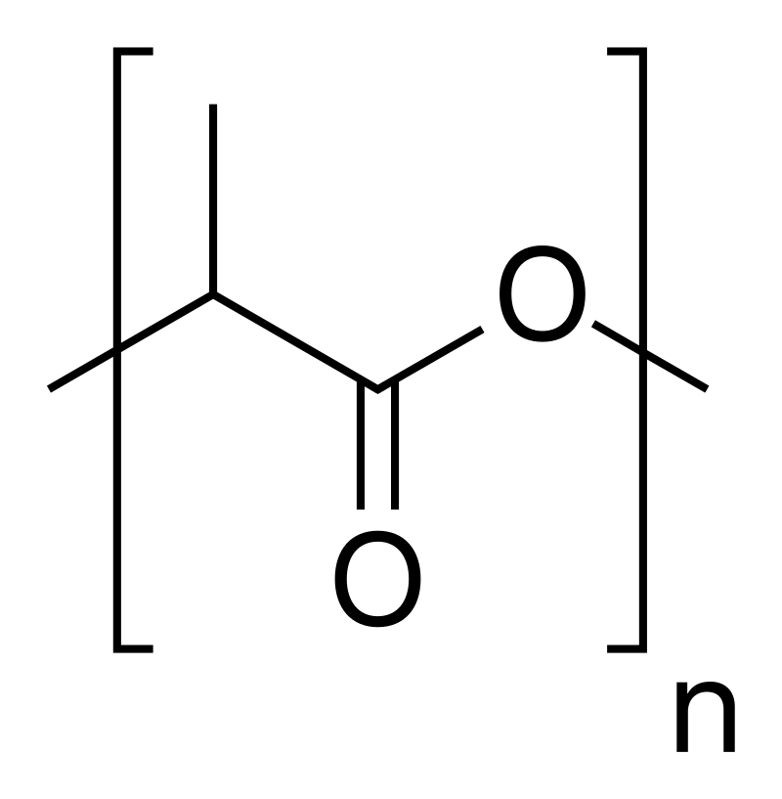
Biodegradable polymers-Polylactic acid
Polylactic acid, also known as poly(lactic acid) or polylactide (abbreviation PLA) is a thermoplastic polyester with backbone formula (C3H4O2)n or [–C(CH3)HC(=O)O–]n, formally obtained by condensation of lactic acid C(CH3)(OH)HCOOH with loss of water (hence its name). It can also be prepared by ring-opening polymerization of lactide [–C(CH3)HC(=O)O–]2, the cyclic dimer of the basic repeating unit.

Slide 46
Synthesis
The monomer is typically made from fermented plant starch such as from corn, cassava, sugarcane or sugar beet pulp.
Several industrial routes afford usable (i.e. high molecular weight) PLA. Two main monomers are used: lactic acid, and the cyclic di-ester, lactide. The most common route to PLA is the ring-opening polymerization of lactide with various metal catalysts (typically tin octoate) in solution or as a suspension. The metal-catalyzed reaction tends to cause racemization of the PLA, reducing its stereoregularity compared to the starting material (usually corn starch).[7]
The direct condensation of lactic acid monomers can also be used to produce PLA. This process needs to be carried out at less than 200 °C; above that temperature, the entropically favored lactide monomer is generated. This reaction generates one equivalent of water for every condensation (esterification) step. The condensation reaction is reversible and subject to equilibrium, so removal of water is required to generate high molecular weight species. Water removal by application of a vacuum or by azeotropic distillation is required to drive the reaction toward polycondensation. Molecular weights of 130 kDa can be obtained this way. Even higher molecular weights can be attained by carefully crystallizing the crude polymer from the melt. Carboxylic acid and alcohol end groups are thus concentrated in the amorphous region of the solid polymer, and so they can react. Molecular weights of 128–152 kDa are obtainable thus.

Slide 47
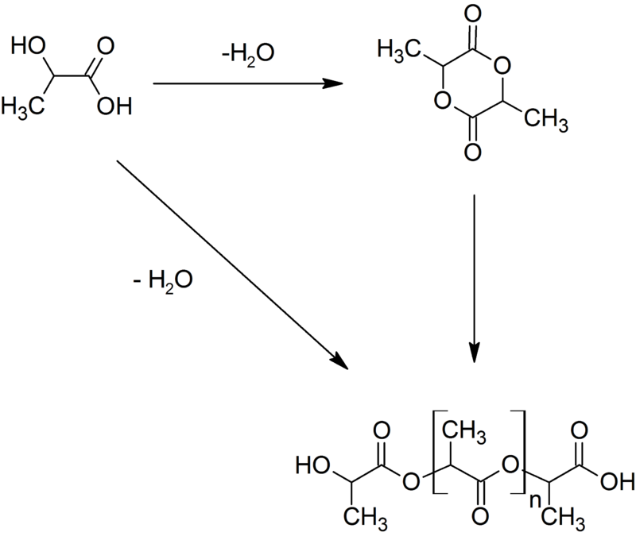

Slide 48
Properties
PLA polymers range from amorphous glassy polymer to semi-crystalline and highly crystalline polymer with a glass transition 60–65 °C, a melting temperature 130-180 °C, and a Young's modulus 2.7–16 GPa.[13][14][15] Heat-resistant PLA can withstand temperatures of 110 °C.[16] The basic mechanical properties of PLA are between those of polystyrene and PET.[13] The melting temperature of PLLA can be increased by 40–50 °C and its heat deflection temperature can be increased from approximately 60 °C to up to 190 °C by physically blending the polymer with PDLA (poly-D-lactide). PDLA and PLLA form a highly regular stereocomplex with increased crystallinity. The temperature stability is maximised when a 1:1 blend is used, but even at lower concentrations of 3–10% of PDLA, there is still a substantial improvement. In the latter case, PDLA acts as a nucleating agent, thereby increasing the crystallization rate[citation needed]. Biodegradation of PDLA is slower than for PLA due to the higher crystallinity of PDLA[citation needed]. The flexural modulus of PLA is higher than polystyrene and PLA has good heat sealability.
Racemic PLA and pure PLLA have low glass transition temperatures, making them undesirable because of low strength and melting point. A stereocomplex of PDLA and PLLA has a higher glass transition temperature, lending it more mechanical strength.

Slide 49
Uses
Consumer goods
PLA is used in a large variety of consumer products such as disposable tableware, cutlery, housings for kitchen appliances and electronics such as laptops and handheld devices, and microwavable trays. (However, PLA is not suitable for microwavable containers because of its low glass transition temperature.) It is used for compost bags, food packaging and loose-fill packaging material that is cast, injection molded, or spun.[35] In the form of a film, it shrinks upon heating, allowing it to be used in shrink tunnels. In the form of fibers, it is used for monofilament fishing line and netting. In the form of nonwoven fabrics, it is used for upholstery, disposable garments, awnings, feminine hygiene products, and diapers.
PLA has applications in engineering plastics, where the stereocomplex is blended with a rubber-like polymer such as ABS. Such blends have good form stability and visual transparency, making them useful in low-end packaging applications.
PLA is used for automotive parts such as floor mats, panels, and covers. Its heat resistance and durability are inferior to the widely used polypropylene (PP), but its properties are improved by means such as capping of the end groups to reduce hydrolysis.[35]

Slide 50
Agricultural
In the form of fibers, PLA is used for monofilament fishing line and netting for vegetation and weed prevention. It is used for sandbags, planting pots, binding tape and ropes .[35]
Medical
PLA can degrade into innocuous lactic acid, so it is used as medical implants in the form of anchors, screws, plates, pins, rods, and mesh.[35] Depending on the exact type used, it breaks down inside the body within 6 months to 2 years. This gradual degradation is desirable for a support structure, because it gradually transfers the load to the body (e.g. to the bone) as that area heals. The strength characteristics of PLA and PLLA implants are well documented.

Slide 51
Conducting Polymers
Please see the pdf given

